Slide 1
Mobile Spyware
Ghazi Eladawi
Mohamed Al-Yazidi
Khaled Omar
Yousef Qumatah

Slide 2
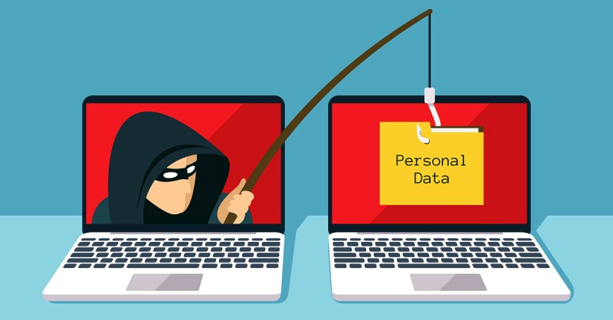
Spyware
Class of Malware focusing on confidentiality.
Types
System Monitors
Trojans
Adware
Tracking Cookies

Slide 3
Mobile Spyware
Limited-Hardware Resources
Client-side Crypto.
Android vs iOS
Variability

Slide 4
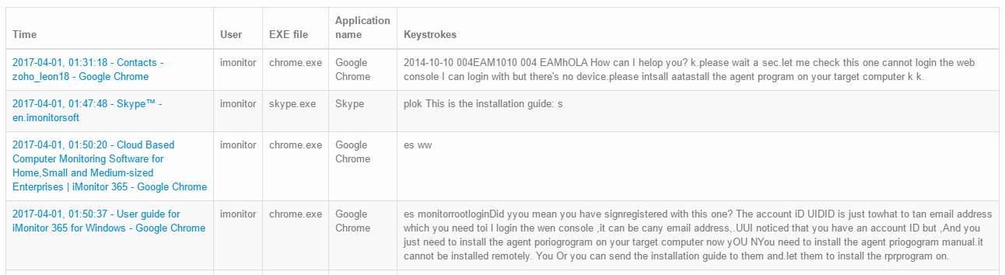
System Monitors
Direct monitoring of device systems : microphone, webcam , many more...
Commercial Applications
Most known system monitor : Keylogger

Slide 5
Trident Pegasus
NSO Group
Modern Cyber-arms industry
Notable Use Cases
Jamal Khashoggi
Human Rights Activists

Slide 6
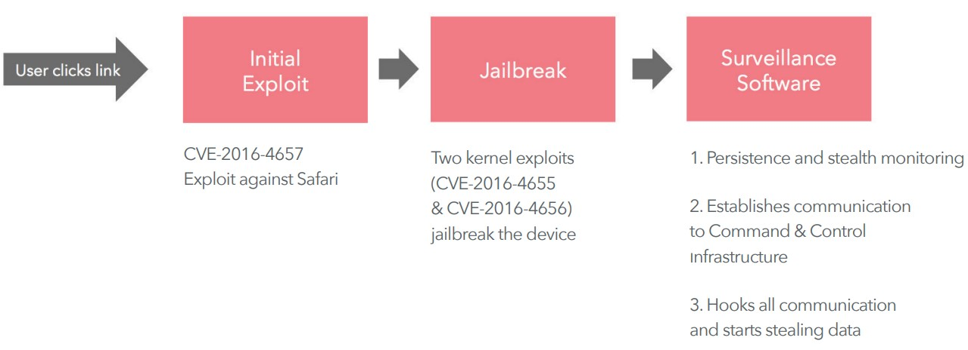
Trident Pegasus
The Trident Vulnerabilities

Slide 7
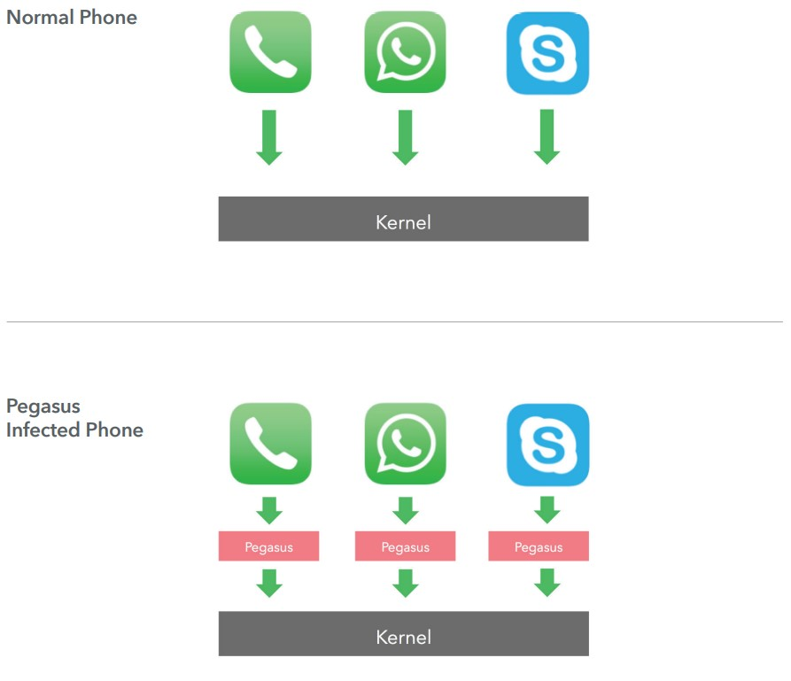
Trident Pegasus
Hooking Application when iPhone is Jailbroken

Slide 8
- Trojans are programs that seems legitimate, but they are actually malicious programs.
- In the context of mobile spyware there are many Trojan programs that can infect mobile phones.
A trojan malicious implant can be used on a devices, mainly to:
listen to the phone microphone
take pictures with the phone’s camera.
find the phone location.
read text messages.
download the phone call log,
steal users’ passwords by logging keystrokes.
Trojans

Slide 9
- In the last 20 years there was about 29 reported trojan attacks, which targeted different OS’s.
Trojan Attacks
An example of one of the reported attacks which was back in 2010,Called Zitmo (Zeus-in-the-mobile).
It targeted blackberry, and android devices.
It was used for online banking attacks.
It captures one-time passcodes that the banks send to users for two-factor authentication.
Another example of one of the reported attacks which was back in 2015,Called XcodeGhost
It targeted apple’s iOS phones.
It was used to infect apps.
The infected app that the users have in their phones will allow the attacker to steal different kind of information.

Slide 11
Preventions
Never click suspicious links.
using strong, unique passwords for online banking applications, or any type of account.
enabling two-way authentication whenever possible.
using spam filters to protect spoofed emails from being sent.
always keep updating the software programs and the OS.
log into accounts through browsers, or official apps (not from a link from email or text).

Slide 12

Adware
What is adware?
How does adware work?
Is adware dangerous?

Slide 13

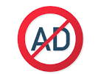


Adware
Positive impact of adware
- Free advertisement.
- influence developers.
Negative impact of adware
- Unwanted advertisements.
- Could affect government processes.

Slide 14

Tracking Cookies
what is cookies?
HTTP cookies. Cookies are small chunks of data that websites store on a user’s machine. This data typically contains various meta-information about the user.
Very useful tool but can be harmful

Slide 15
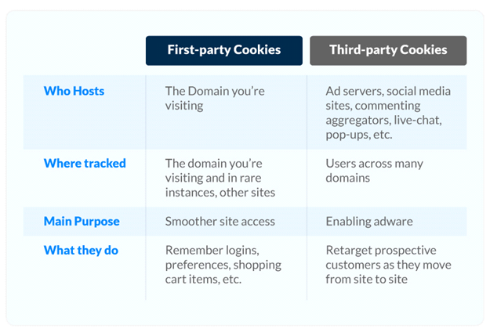
First-Party VS Third-Party

Slide 16
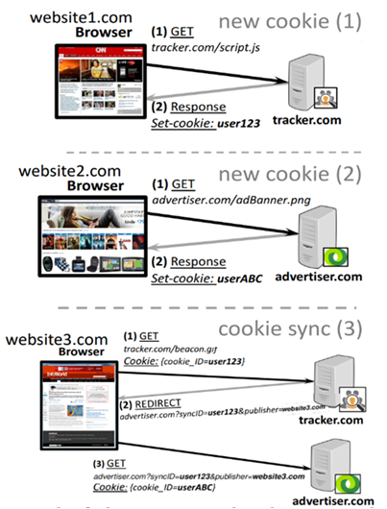
Cookie Synchronization
Cookie-syncing is a process that enables the ad-tech partners to synchronize their cookies and share the incorporated user’s data from different websites

Slide 17
History Sniffing
CSS-based attacks: Popular approach to detect if a user has visited other websites is to check the CSS style used to render links.
Timing-based attacks: due to the high customization present in current websites. It is also possible to detect if the user is currently logged in to certain websites by timing of specific requests.

Slide 18
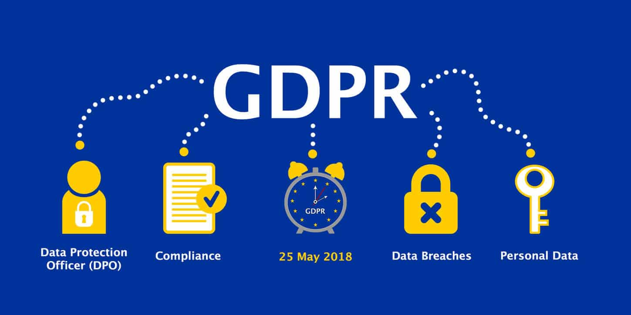

Protection
installing user extension like Privacy Ghostery. browser with built-in privacy protection tools like Brave or Safari.
the best solution to protect users is using the laws like in Europe, they have the GDPR (General Data Protection Regulation )

Slide 19
Thanks for Listening!

